Slide 1
Quantum Software Architecture: Mapping Quantum Algorithms to Devices
January 11, 2015
QIP 2015
Krysta Svore
Quantum Architectures and Computation Group (QuArC)
Microsoft Research

Slide 2
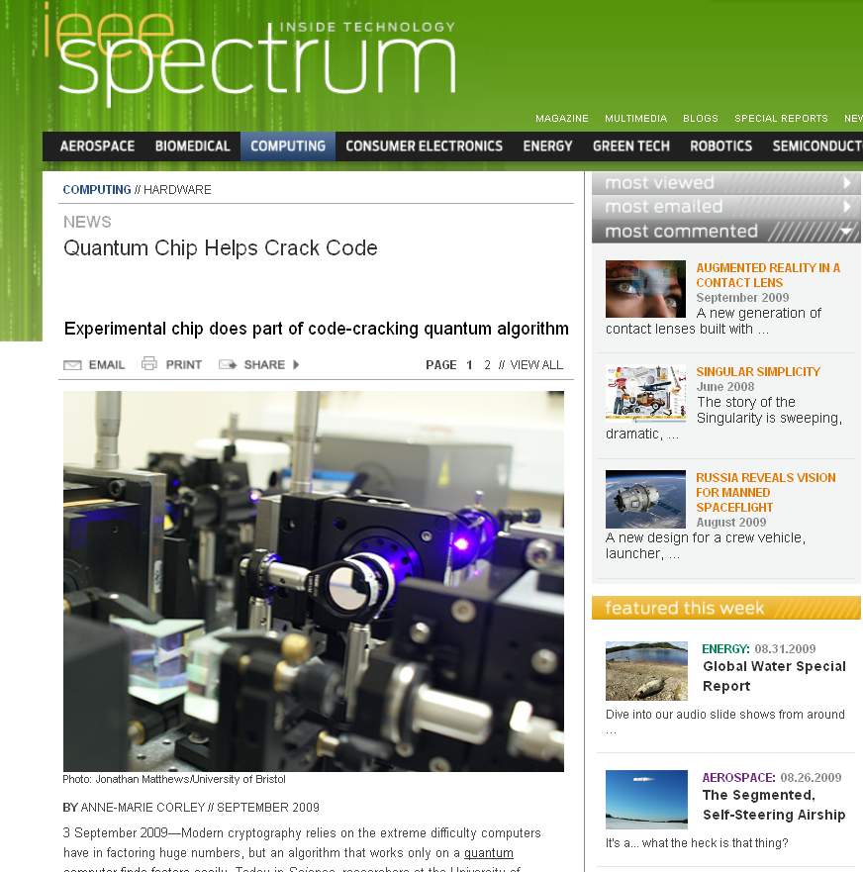
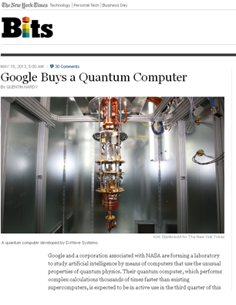
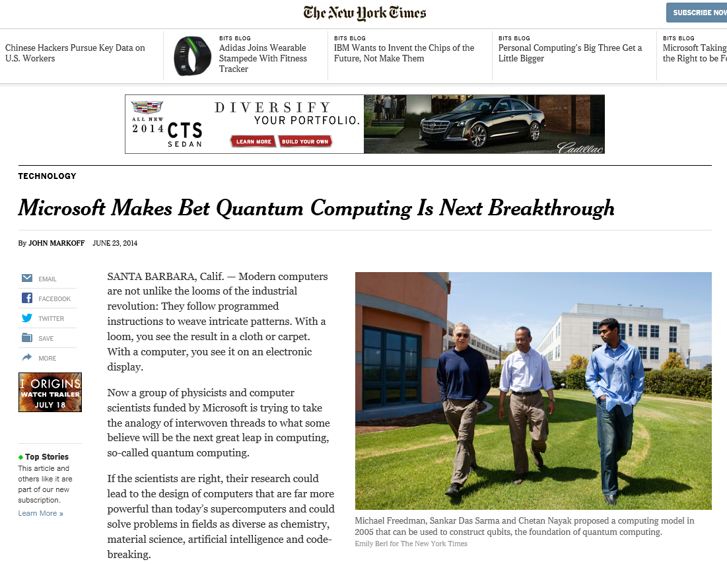
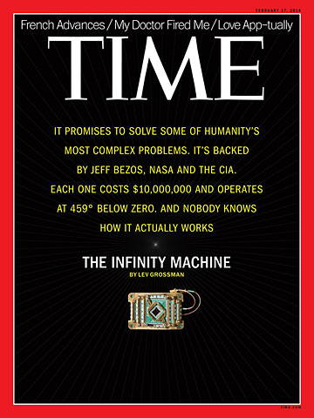
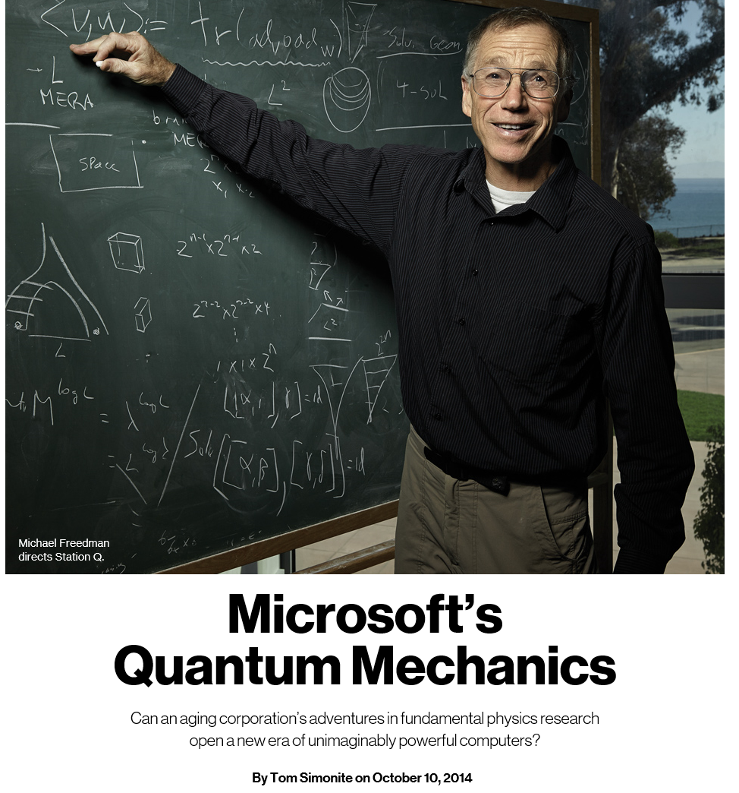
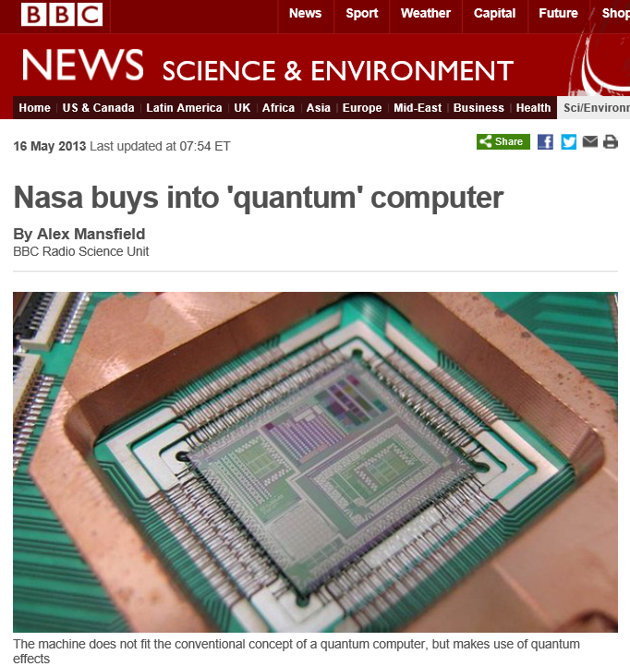

Slide 3
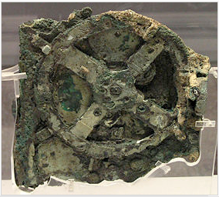
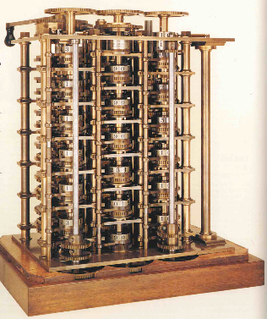
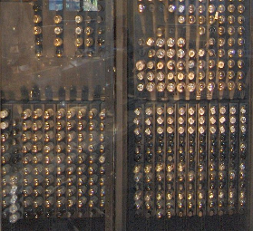
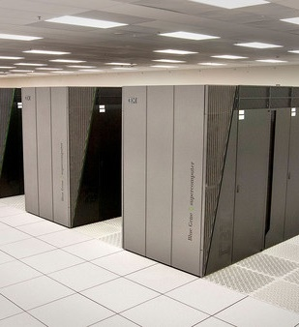
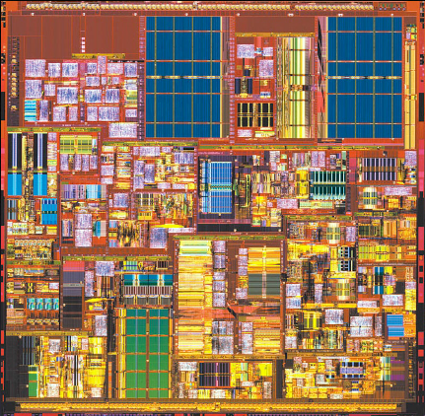
Computers have come a long way
Antikythera mechanism
(100 BC)
Babbage’s Difference Engine
(proposed 1822)
ENIAC
(1946)
Sequoia
(2012)
Quantum
(20??)
Thanks to Matthias Troyer

Slide 4
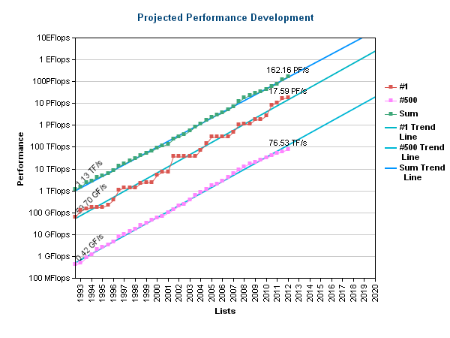
Success of digital computers (Moore’s Law)
Is there anything we can’t solve on digital computers?
4

Slide 5
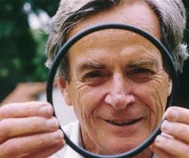
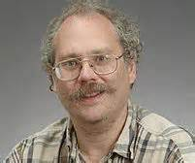
Some problems are hard to solve
QMA-Hard
QMA
NP-Hard
BQP
NP
P
An Ultimate Goal:
Develop quantum algorithms whose complexity lies in BQP\P

Slide 6
Requirements for quantum computation
Quantum algorithms:
Design real-world quantum algorithms for small-, medium- and large-scale quantum computers
Quantum hardware architecture:
Architect a scalable, fault-tolerant, and fully programmable quantum computer
Quantum software architecture:
Program and compile complex algorithms into optimized, target-dependent (quantum and classical) instructions

Slide 7
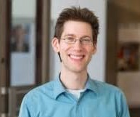
Quantum Algorithms Exist!
Shor’s Algorithm (1994)
Breaks RSA, elliptic curve signatures, DSA, El-Gamal
Exponential speedups
Solving Linear Systems of Equations (2010)
Applications shown for electromagnetic wave scattering
Exponential speedups
Quantum simulation (1982)
Simulate physical systems in a quantum mechanical device
Exponential speedups

Slide 8
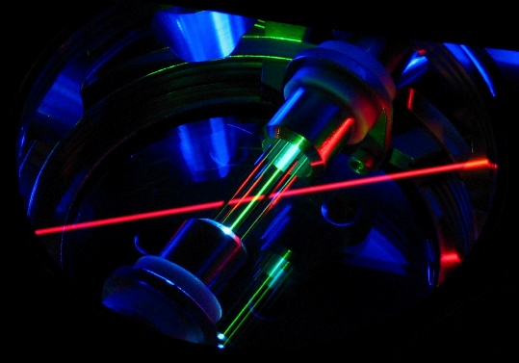
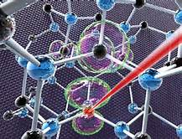
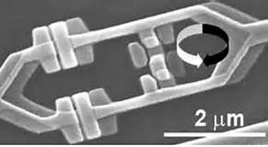
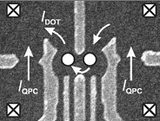
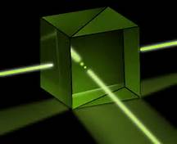
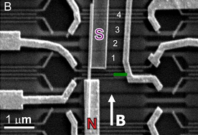
Quantum Hardware Technologies Exist!
Ion traps
NV centers
Super-conductors
Quantum dots
Linear optics
Topological

Slide 9
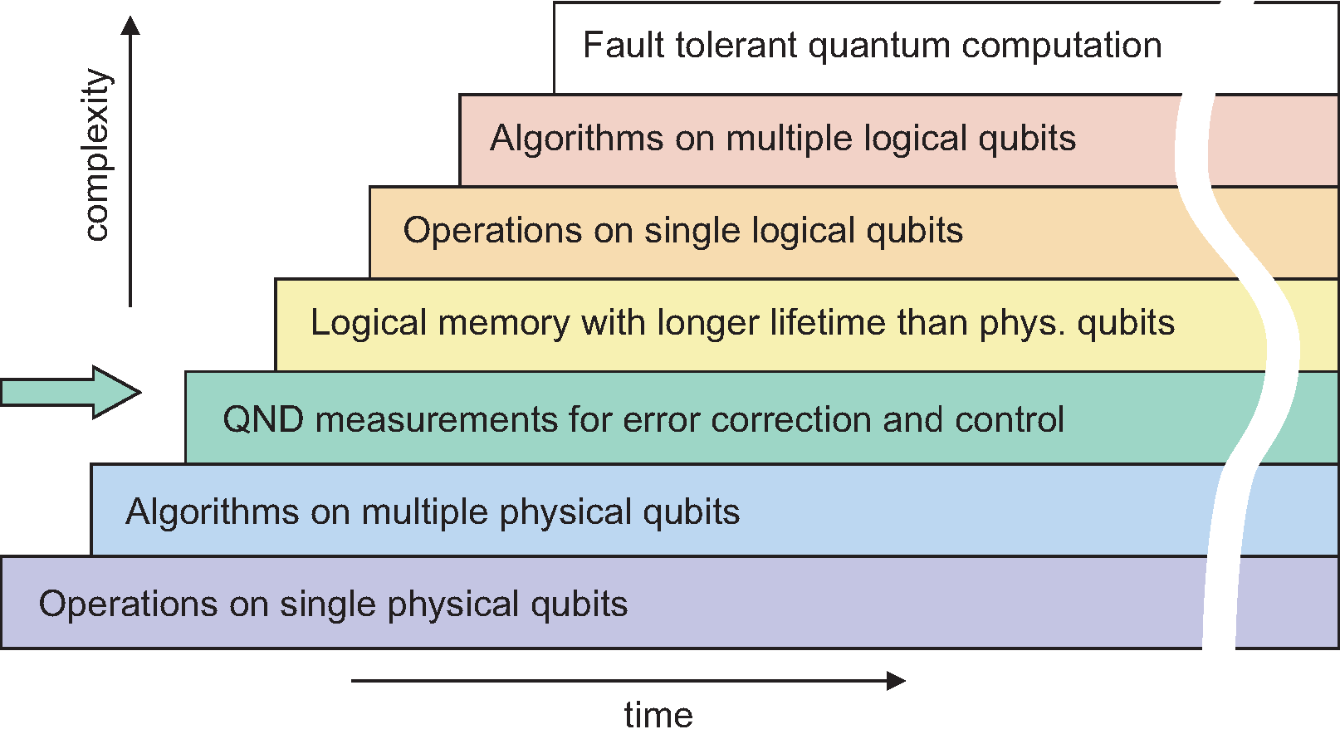
Quantum computing through the Ages
“Age of Scalability”
“Age of Algorithms”
“Age of Quantum Error Correction”
“Age of Quantum Feedback”
“Age of Measurement”
“Age of Entanglement”
“Age of Coherence”
“We” are ~ here
M. Devoret and R. Schoelkopf, Science (2013)

Slide 10
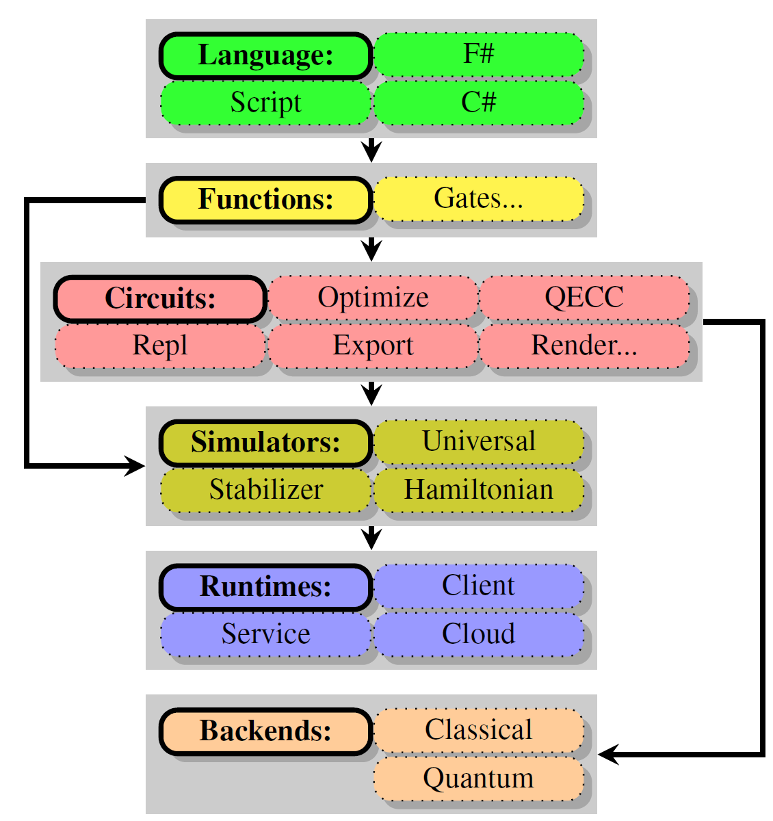

A Software Architecture for Quantum Computing
High-level Quantum Algorithm
Quantum Gates
Quantum Function Implementation
Quantum Circuit Decomposition
Quantum Circuit Optimization
Quantum Error Correction
Simulation
Runtime Environments
Target-dependent Optimization
Layout, Scheduling, Control
Target-dependent Representation
Classical Control/Quantum Machine Instructions
The LIQ$Ui|⟩ \text{platform}$
[Wecker and Svore, 2014]

Slide 11

LIQ$Ui|⟩$ Goals
Language Design and Simulation:
High (enough) level language to easily implement large quantum algorithms
Allow as large a simulation on classical computers as possible
Support abstraction and visualization to help the user
Implement as an extensible platform so users can tailor to their own requirements
Compilation:
Multi-level analysis of circuits to allow many types of optimization
Circuit re-writing for specific needs (e.g., different gate sets, noise modeling)
Compilation into real target architectures (e.g., physics experiments)
[Wecker and Svore 2014]

Slide 12

The LIQ$Ui|⟩$ Platform
Language
F#
Script
C#
Gates …
Circuit
Optimize
QECC
Rewrite
Noise
Export
Render…
Simulators
Universal
Stabilizer
Hamiltonian
Runtime
Back End …
Client
Service
Cloud
Classical
Quantum
Microsoft Proprietary

Slide 13
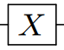



Quantum Gates: Digital quantum computation
Basic unit: qubit = unit vector
$$α\left|0\right\rangle +β\left|1\right\rangle$$
Computing: unitary operation
Basic unit: bit = 0 or 1
Computing: logical operation
NOT
$$0→1$$
$$1→0$$
NOT
$$\left[\begin{matrix}0 & 1 \\ 1 & 0\end{matrix}\right]\left[\begin{matrix}α \\ β\end{matrix}\right]=\left[\begin{matrix}β \\ α\end{matrix}\right]$$

Slide 14
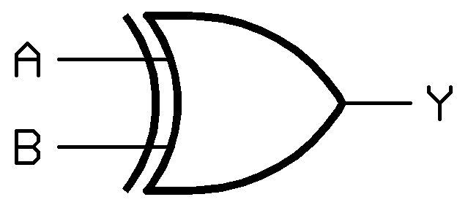
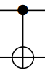


Quantum Gates: Digital quantum computation
Basic unit: qubit = unit vector
$$α\left|0\right\rangle +β\left|1\right\rangle$$
Computing: unitary operation
Description: unitary matrix
Basic unit: bit = 0 or 1
Computing: logical operation
Description: truth table
A | B | Y
0 | 0 | 0
0 | 1 | 1
1 | 0 | 1
1 | 1 | 0
$$\left[\begin{matrix}1 & 0 & 0 & 0 \\ 0 & 1 & 0 & 0 \\ 0 & 0 & 0 & 1 \\ 0 & 0 & 1 & 0\end{matrix}\right]$$
XOR gate
CNOT gate

Slide 15

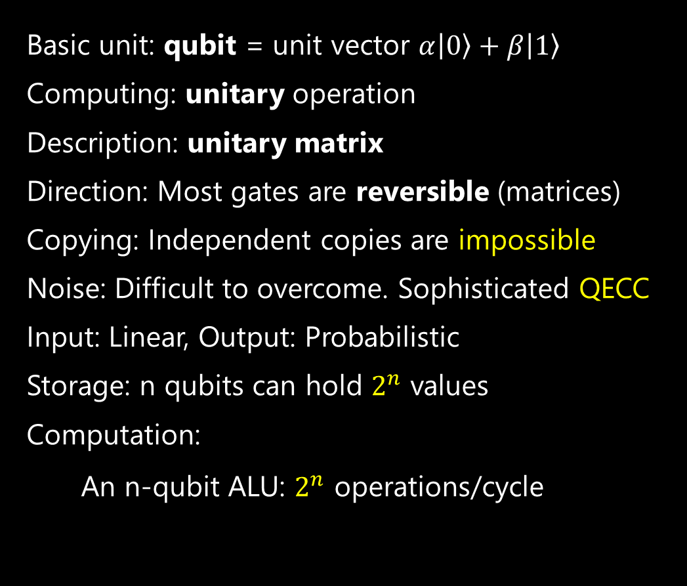
Classical vs. Quantum Computing
Basic unit: bit = 0 or 1
Computing: logical operation
Description: truth table
Direction: Most gates only run forward
Copying: Independent copies are easy
Noise: Manageable with minimal ECC
Input/Output: Linear
Storage: n bits hold 1 value from 0 to $2^{n}−1$
Computation:
An n-bit ALU: 1 operation/cycle
Basic unit: qubit = unit vector $α\left|0\right\rangle +β\left|1\right\rangle$
Computing: unitary operation
Description: unitary matrix
Direction: Most gates are reversible (matrices)
Copying: Independent copies are impossible
Noise: Difficult to overcome. Sophisticated QECC
Input: Linear, Output: Probabilistic
Storage: n qubits can hold $2^{n}$ values
Computation:
An n-qubit ALU: $2^{n}$ operations/cycle

Slide 16
Languages for expressing logical quantum circuits
Example: QFT on 5 qubits
.qc
QASM
Quipper
QuIGL
[Lapets and Roetteler 2013]
.v 1 2 3 4 5 6
.i 1 2 3 4 5 6
.o 1 2 3 4 5 6
.ol
.c
BEGIN
H 1
RZ(1 pi/2) 2 1
H 2
RZ(1 pi/4) 3 1
RZ(1 pi/2) 3 2
H 3
RZ(1 pi/8) 4 1
RZ(1 pi/4) 4 2
RZ(1 pi/2) 4 3
H 4
RZ(1 pi/16) 5 1
RZ(1 pi/8) 5 2
RZ(1 pi/4) 5 3
RZ(1 pi/2) 5 4
H 5
RZ(1 pi/32) 6 1
RZ(1 pi/16) 6 2
RZ(1 pi/8) 6 3
RZ(1 pi/4) 6 4
RZ(1 pi/2) 6 5
H 6;
END
defbox CU,3,1,'U'
defbox CU2,3,1,'U^2'
defbox CU4,3,1,'U^4'
def c-S,1,'S'
def c-T,1,'T'
qubit j0,0 # QFT qubits
qubit j1,0
qubit j2,0
qubit s0 # U qubits
qubit s1
h j0 # equal superposition
h j1
h j2
CU4 j0,s0,s1 # controlled-U
CU2 j1,s0,s1
CU j2,s0,s1
h j0 # QFT
c-S j0,j1
h j1
nop j0
c-T j0,j2
c-S j1,j2
h j2
nop j0
nop j0
Nop j1
qft' :: [Qubit] -> Circ [Qubit]
qft' [] = return []
qft' [x] = do
hadamard x
return [x]
qft' (x:xs) = do
xs' <- qft' xs
xs'' <- rotations x xs' (length xs')
x' <- hadamard x
return (x':xs'')
where
rotations _ [] _ = return []
rotations c (q:qs) n = do
qs' <- rotations c qs n
let m = ((n + 1) - length qs)
q' <- rGate m q `controlled` c
return (q':qs')
circuit {
q := wire [5];
H (q[1]);
control (q[1]) {
phase (q[2]);
};
H (b);
control (q[1]) {
T (q[3]);
};
control (q[2]) { phase (q[3]); };
H (c);
control (q[1]) {
phaseZ [pi/8, 10^(-3)] (q[4]);
};
control (q[2]) {
T (q[4]);
};
control (q[3]) {
phase (q[4]);
};
H (q[4]);
control (q[1]) {
phaseZ [pi/16, 10^(-3)] (q[5]z);
};
control (q[2]) {
phaseZ [pi/8, 10^(-3)] (q[5]);
};
control (q[3]) {
T (q[5]);
};
control (q[4]) {
phase (q[5]);
};
H (q[5]);
}
[Selinger and Valiron 2013]
[Cross 2005]
Low-level, assembly like languages
High-level, embedded languages

Slide 17
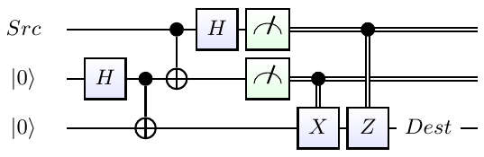
Teleport: Quantum “Hello World”
Alice entangles two qubits
Bob takes one of them far away
Alice is given a new qubit with a message
Alice entangles it with her local part of the Bell pair
Alice measure the local qubits, yielding 2 classical bits
Alice transmits the two bits via classical channels
Remotely, Bob applies gates as determined by the 2 bits
Bob recovers the sent message

Slide 18
Teleport: User Code
Define a function to perform entanglement:
let EPR (qs:Qubits) = H qs; CNOT qs
The rest of the algorithm:
let teleport (qs:Qubits) =
let qs' = qs.Tail
EPR qs'; CNOT qs; H qs
M qs'; BC X qs'
M qs ; BC Z !!(qs,0,2)
Microsoft Proprietary

Slide 19
Teleport: Running the Code
loop N times:
… create 3 qubits
… init the first one to a random state
… print it out
teleport qs
… print out the result
0:0000.0/Initial State: ( 0.3735-0.2531i)|0>+( -0.4615-0.7639i)|1>
0:0000.0/Final State: ( 0.3735-0.2531i)|0>+( -0.4615-0.7639i)|1> (bits:10)
0:0000.0/Initial State: ( -0.1105+0.3395i)|0>+( 0.927-0.1146i)|1>
0:0000.0/Final State: ( -0.1105+0.3395i)|0>+( 0.927-0.1146i)|1> (bits:11)
0:0000.0/Initial State: ( -0.3882-0.2646i)|0>+( -0.8092+0.3528i)|1>
0:0000.0/Final State: ( -0.3882-0.2646i)|0>+( -0.8092+0.3528i)|1> (bits:01)
0:0000.0/Initial State: ( 0.2336+0.4446i)|0>+( -0.8527+0.1435i)|1>
0:0000.0/Final State: ( 0.2336+0.4446i)|0>+( -0.8527+0.1435i)|1> (bits:10)
0:0000.0/Initial State: ( 0.9698+0.2302i)|0>+(-0.03692+0.0717i)|1>
0:0000.0/Final State: ( 0.9698+0.2302i)|0>+(-0.03692+0.0717i)|1> (bits:11)
0:0000.0/Initial State: ( -0.334-0.3354i)|0>+( 0.315-0.8226i)|1>
0:0000.0/Final State: ( -0.334-0.3354i)|0>+( 0.315-0.8226i)|1> (bits:01)
Microsoft Proprietary

Slide 20
User definition of a gate
/// <summary>
/// Controlled NOT gate
/// </summary>
/// <param name="qs"> Use first two qubits for gate</param>
[<LQD>]
let CNOT (qs:Qubits) =
let gate =
Gate.Build("CNOT",fun () ->
new Gate(
Name = "CNOT",
Help = "Controlled NOT",
Mat = CSMat(4,[(0,0,1.,0.);(1,1,1.,0.);
(2,3,1.,0.);(3,2,1.,0.)]),
Draw = "\\ctrl{#1}\\go[#1]\\targ"
))
gate.Run qs
Microsoft Proprietary

Slide 21
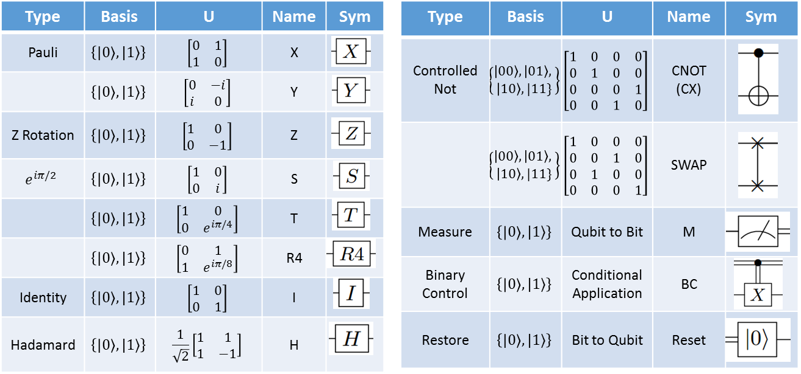
Quantum Gate Library

Slide 22
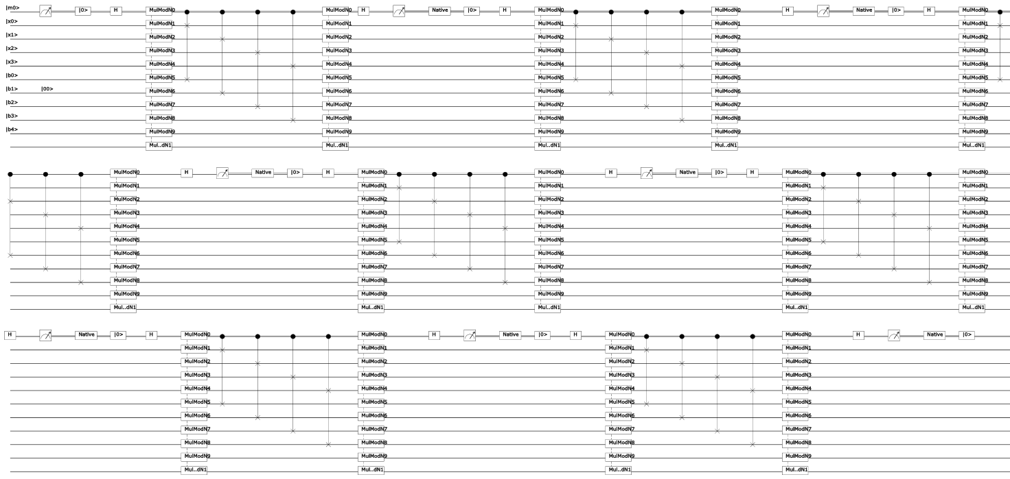

Shor’s algorithm: Full Circuit - 4 bits $≅$ 8200 gates
Largest we’ve done:
14 bits (factoring 8193)
14 Million Gates
30 days
Circuit for Shor’s algorithm using 2n+3 qubits – Stéphane Beauregard
Microsoft Proprietary

Slide 23
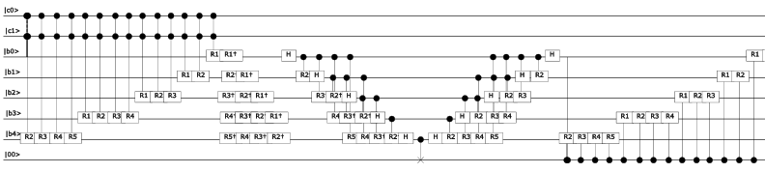
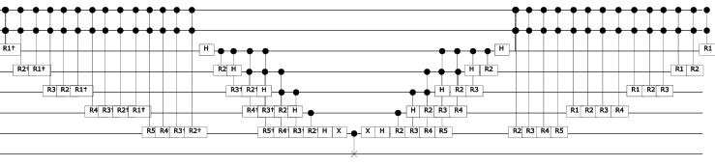
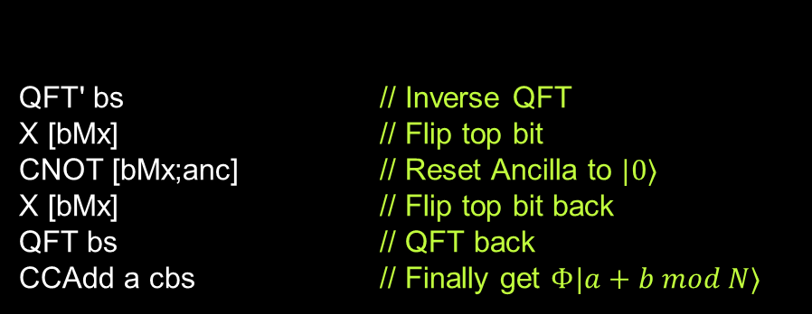
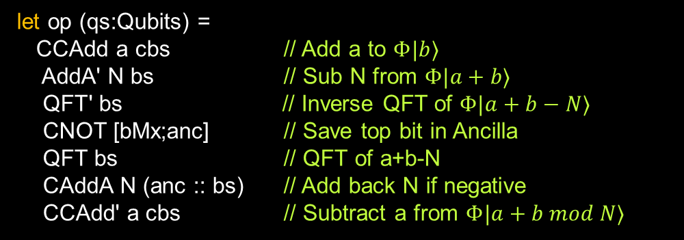
Shor’s algorithm: Modular Adder
As defined in:
Circuit for Shor’s
algorithm using 2n+3 qubits
– Stéphane Beauregard
let op (qs:Qubits) =
CCAdd a cbs // Add a to $Φ|b⟩$
AddA' N bs // Sub N from $Φ|a+b⟩$
QFT' bs // Inverse QFT of $Φ|a+b−N⟩$
CNOT [bMx;anc] // Save top bit in Ancilla
QFT bs // QFT of a+b-N
CAddA N (anc :: bs) // Add back N if negative
CCAdd' a cbs // Subtract a from $Φ|a+b mod N⟩$
QFT' bs // Inverse QFT
X [bMx] // Flip top bit
CNOT [bMx;anc] // Reset Ancilla to $|0⟩$
X [bMx] // Flip top bit back
QFT bs // QFT back
CCAdd a cbs // Finally get $Φ|a+b mod N⟩$
Microsoft Proprietary

Slide 24
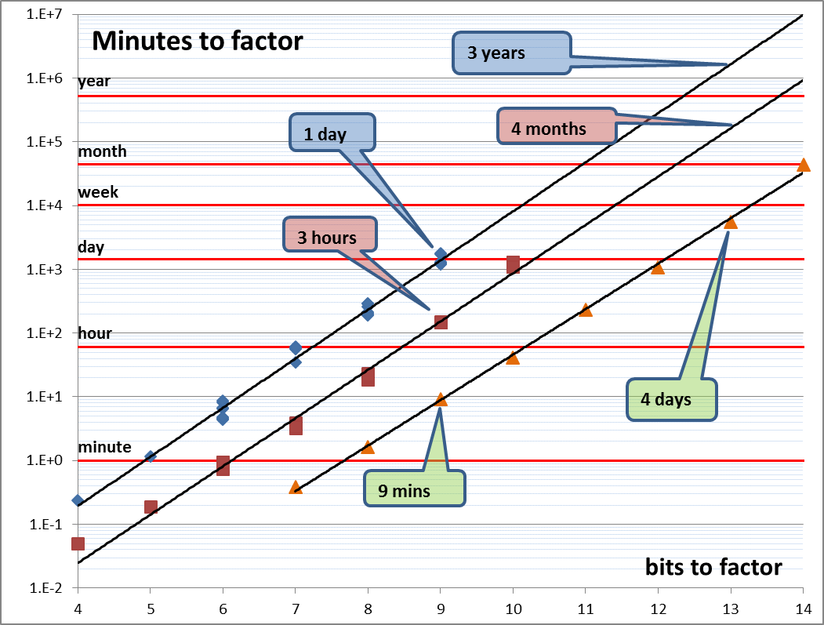
Shor’s algorithm simulation
Microsoft Proprietary

Slide 25
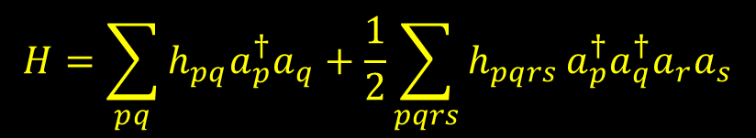
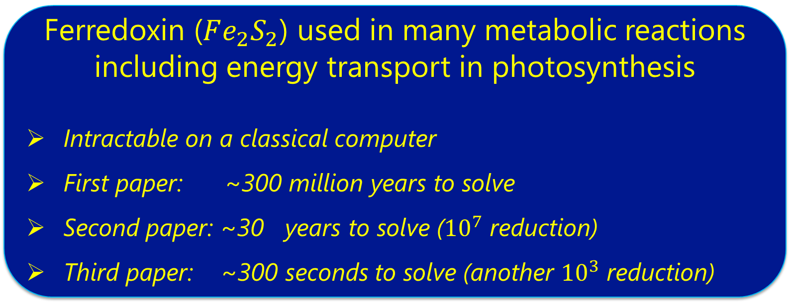
Quantum Chemistry
$$H=\sum_{pq}{h_{pq}a_{p}^{†}a_{q}+\frac{1}{2}\sum_{pqrs}{h_{pqrs }a_{p}^{†}a_{q}^{†}a_{r}a_{s}}}$$
Can quantum chemistry be performed on a small quantum computer: Dave Wecker, Bela Bauer, Bryan K. Clark, Matthew B. Hastings, Matthias Troyer
As quantum computing technology improves and quantum computers with a small but non-trivial number of N > 100 qubits appear feasible in the near future the question of possible applications of small quantum computers gains importance. One frequently mentioned application is Feynman's original proposal of simulating quantum systems, and in particular the electronic structure of molecules and materials. In this paper, we analyze the computational requirements for one of the standard algorithms to perform quantum chemistry on a quantum computer. We focus on the quantum resources required to find the ground state of a molecule twice as large as what current classical computers can solve exactly. We find that while such a problem requires about a ten-fold increase in the number of qubits over current technology, the required increase in the number of gates that can be coherently executed is many orders of magnitude larger. This suggests that for quantum computation to become useful for quantum chemistry problems, drastic algorithmic improvements will be needed.
The Trotter Step Size Required for Accurate Quantum Simulation of Quantum Chemistry
David Poulin, M. B. Hastings, Dave Wecker, Nathan Wiebe, Andrew C. Doherty, Matthias Troyer
The simulation of molecules is a widely anticipated application of quantum computers. However, recent studies \cite{WBCH13a,HWBT14a} have cast a shadow on this hope by revealing that the complexity in gate count of such simulations increases with the number of spin orbitals N as N8, which becomes prohibitive even for molecules of modest size N∼100. This study was partly based on a scaling analysis of the Trotter step required for an ensemble of random artificial molecules. Here, we revisit this analysis and find instead that the scaling is closer to N6 in worst case for real model molecules we have studied, indicating that the random ensemble fails to accurately capture the statistical properties of real-world molecules. Actual scaling may be significantly better than this due to averaging effects. We then present an alternative simulation scheme and show that it can sometimes outperform existing schemes, but that this possibility depends crucially on the details of the simulated molecule. We obtain further improvements using a version of the coalescing scheme of \cite{WBCH13a}; this scheme is based on using different Trotter steps for different terms. The method we use to bound the complexity of simulating a given molecule is efficient, in contrast to the approach of \cite{WBCH13a,HWBT14a} which relied on exponentially costly classical exact simulation.
http://arxiv.org/abs/1406.4920
Improving Quantum Algorithms for Quantum Chemistry: M. B. Hastings, D. Wecker, B. Bauer, M. Troyer
We present several improvements to the standard Trotter-Suzuki based algorithms used in the simulation of quantum chemistry on a quantum computer. First, we modify how Jordan-Wigner transformations are implemented to reduce their cost from linear or logarithmic in the number of orbitals to a constant. Our modification does not require additional ancilla qubits. Then, we demonstrate how many operations can be parallelized, leading to a further linear decrease in the parallel depth of the circuit, at the cost of a small constant factor increase in number of qubits required. Thirdly, we modify the term order in the Trotter-Suzuki decomposition, significantly reducing the error at given Trotter-Suzuki timestep. A final improvement modifies the Hamiltonian to reduce errors introduced by the non-zero Trotter-Suzuki timestep. All of these techniques are validated using numerical simulation and detailed gate counts are given for realistic molecules.
http://arxiv.org/abs/1312.1695
http://arxiv.org/abs/1403.1539
Ferredoxin ($Fe_{2}S_{2}$) used in many metabolic reactions
including energy transport in photosynthesis
Intractable on a classical computer
First paper: ~300 million years to solve
Second paper: ~30 years to solve (${10}^{7}$ reduction)
Third paper: ~300 seconds to solve (another ${10}^{3}$ reduction)
Microsoft Proprietary

Slide 26
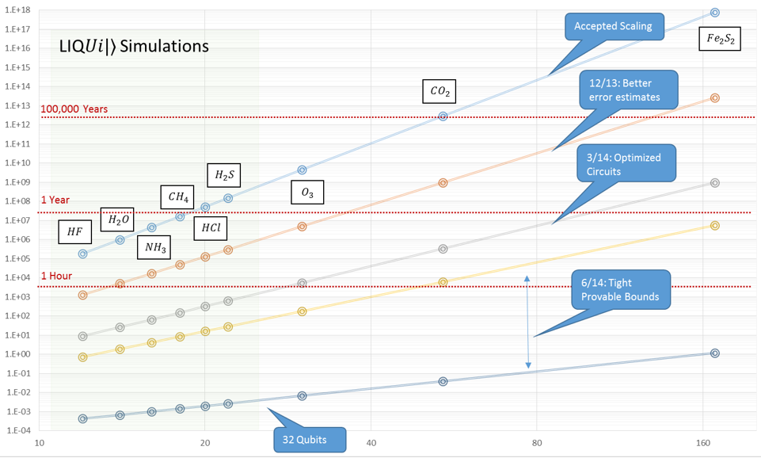
Quantum Chemistry
$$H=\sum_{pq}{h_{pq}a_{p}^{†}a_{q}+\frac{1}{2}\sum_{pqrs}{h_{pqrs }a_{p}^{†}a_{q}^{†}a_{r}a_{s}}}$$

Slide 27

A Software Architecture for Quantum Computing
High-level Quantum Algorithm
Quantum Gates
Quantum Function Implementation
Quantum Circuit Decomposition
Quantum Circuit Optimization
Quantum Error Correction
Simulation
Runtime Environments
Target-dependent Optimization
Layout, Scheduling, Control
Target-dependent Representation
Classical Control/Quantum Machine Instructions
The LIQ$Ui|⟩ \text{platform}$
[Wecker and Svore, 2014]

Slide 28
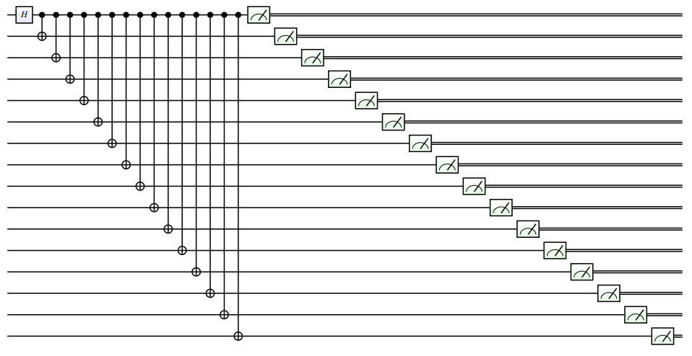
Building Larger Circuits
let entangle (qs:Qubits) =
H qs; let q0 = qs.Head
for q in qs.Tail do CNOT[q0;q]
M >< qs
0:0000.0/#### Iter 0 [ 0.2030]: 0000000000000
0:0000.0/#### Iter 1 [ 0.1186]: 0000000000000
0:0000.0/#### Iter 2 [ 0.0895]: 0000000000000
0:0000.0/#### Iter 3 [ 0.0749]: 0000000000000
0:0000.0/#### Iter 4 [ 0.0664]: 1111111111111
0:0000.0/#### Iter 5 [ 0.0597]: 0000000000000
0:0000.0/#### Iter 6 [ 0.0550]: 1111111111111
0:0000.0/#### Iter 7 [ 0.0512]: 0000000000000
0:0000.0/#### Iter 8 [ 0.0484]: 0000000000000
0:0000.0/#### Iter 9 [ 0.0463]: 0000000000000
0:0000.0/#### Iter 10 [ 0.0446]: 0000000000000
0:0000.0/#### Iter 11 [ 0.0432]: 1111111111111
0:0000.0/#### Iter 12 [ 0.0420]: 0000000000000
0:0000.0/#### Iter 13 [ 0.0410]: 0000000000000
0:0000.0/#### Iter 14 [ 0.0402]: 0000000000000
0:0000.0/#### Iter 15 [ 0.0399]: 0000000000000
0:0000.0/#### Iter 16 [ 0.0392]: 1111111111111
0:0000.0/#### Iter 17 [ 0.0387]: 1111111111111
0:0000.0/#### Iter 18 [ 0.0380]: 0000000000000
0:0000.0/#### Iter 19 [ 0.0374]: 1111111111111
Microsoft Proprietary

Slide 29
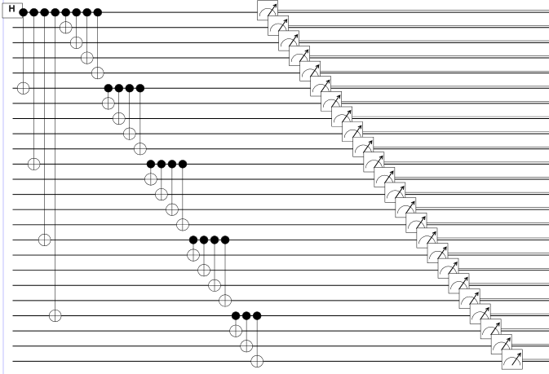
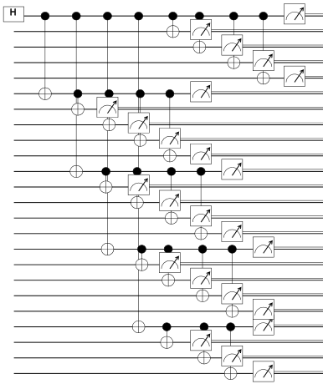
Optimizing Circuits
48 time steps
10 time steps
Microsoft Proprietary

Slide 30
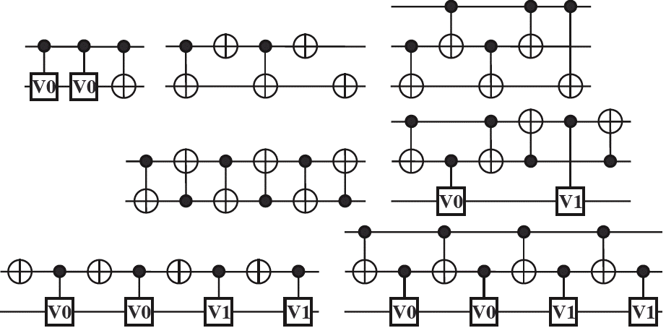
Optimizing circuits: rewriting templates
Use string rewriting rules
Basic idea:
Obstacles:
Number of rules grows fast
Some gates may commute
Need good reduction strategies
=
Templates:
[Maslov, Young, Miller, Dueck, Quantum Circuit Simplification Using Templates, DATE’05]
[Slide by Dmitri Maslov]

Slide 31
Optimizing circuits: time-space tradeoffs
Let A be an algorithm with time complexity T and space complexity S.
Using reversible pebble game, [Bennett, SIAM J. Comp. 1989]
showed that for any ε>0 there is a reversible algorithm A’ with
time complexity O(T^{1+ ε}) and space complexity O(S ln(T)).
Issue: one cannot simply take the limit ε→0. The space would
grow in an unbounded way (as O(ε2^{1/ε} S ln(T))).
Improved analysis [Levine, Sherman, SIAM J. Comp. 1990]
showed that for any ε>0 there is a reversible algorithm A’ with
time complexity O(T^{1+ ε}/S ^{ε}) and space complexity O(S (1+ln(T/S))).
Other time/space tradeoffs: [Buhrman, Tromp, Vitányi, ICALP’01]
Research: develop a “compiler” that takes a classical combinational circuit as input and translates it into a reversible circuit, with respect to various resource constraints.

Slide 32
A Software Architecture for Quantum Computing
High-level Quantum Algorithm
Quantum Gates
Quantum Function Implementation
Quantum Circuit Decomposition
Quantum Circuit Optimization
Quantum Error Correction
Simulation
Runtime Environments
Target-dependent Optimization
Layout, Scheduling, Control
Target-dependent Representation
Classical Control/Quantum Machine Instructions
The LIQ$Ui|⟩ \text{platform}$
[Wecker and Svore, 2014]

Slide 33






Quantum Hardware: What’s the catch?
Need coherent
control
Need strongly
interacting system
$$|ψ_{1}〉$$
$$|ψ_{2}〉$$
$$|ψ_{0}〉$$
$$|ψ_{3}〉$$
Avoid interaction with
outside environment!
Can’t perform an
arbitrary size unitary!
(coming in Part II)
$$|ψ_{4}〉$$
Decoherence
and errors!
Thanks to Rob Schoelkopf

Slide 34
Classical Error Correction
0
1-p
0
p
Probability p of having
a bit flipped
Sent
Received
p
1
1
1-p
Repetition code: redundantly encode, majority voting
0 000
1 111
Reduces classical error rate to 3p² – 2p³
Can we do this for quantum computing? Maybe not:
“No cloning” theorem
Errors seem to be continuous
Measurements change the state

Slide 35
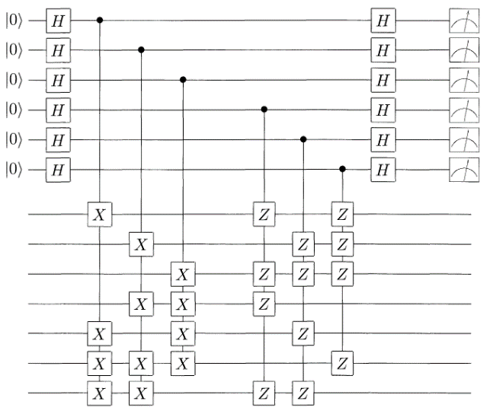
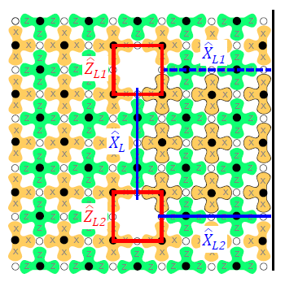
Possible Error Correction Architectures
Standard QEC
Surface Code
Modular Approach
…
Switchable Router
…
Overhead required in known schemes: 1,000s physical qubits for every logical qubit
7 or 9 physical qubits per logical (+ concatenation!)
threshold ~ 10⁻⁴
many operations, syndromes per QEC cycle
10² – 10⁴ /logical
threshold ~ 1%
simulate large system to see effects
few qubits/ module
good local gates (10⁻⁴?) remote gates fair (90%?)
possible to construct QEC as software layer
Thanks to Rob Schoelkopf

Slide 36
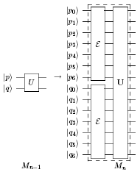
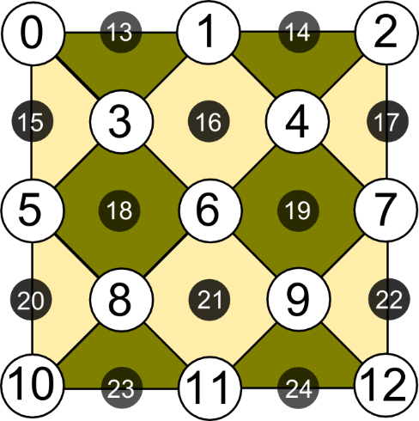

Fault-tolerant Replacement Rules
Given a set of fault-tolerant replacement rules:
Replace each circuit location with a fault-tolerant gadget
25 qubits
Fault-tolerant replacement rules have been developed for a discrete, universal set of gates!
X_{L}
Z_{L}

Slide 37
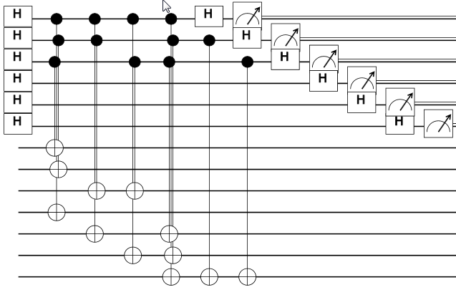

QECC: Quantum Error Correction Codes
LIQ$Ui|⟩$ has a user extensible module allowing circuits to be re-written automatically with logical qubits representing many physical qubits (may be a 1000:1 ratio).
Quantum error correction codes and corresponding replacement rules can be easily defined.
QECC class allows definition; Inject allows incorporation of error models.
Microsoft Proprietary

Slide 38
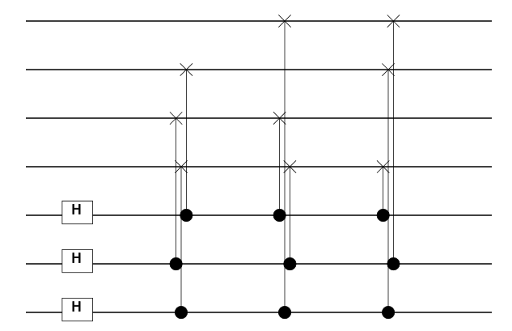
Gate Definition: Steane [[7,1,3]] Prep. Rule
/// <summary>
/// Adjoint of parent gate.
/// </summary>
/// <param name="qs"> Qubits to use with parent gate</param>
[<LQD>] /// Prep gate for Steane7
let prep (qs:Qubits) =
let nam = "S7_Prep"
let nam2= "S7\nPrep"
let gate (qs:Qubits) =
// Create logical |0> prep circuit
let op (qs:Qubits) =
let xH i = H [qs.[i]]
let xC i j = CNOT [qs.[i];qs.[j]]
xH 6; xC 6 3; xH 5; xC 5 2; xH 4
xC 4 1; xC 5 3; xC 4 2; xC 6 0; xC 6 1
xC 5 0; xC 4 3
Gate.Build(nam,fun () ->
new Gate(
Qubits = qs.Length,
Name = nam,
Help = "Prepare logical 0 state",
Render = [Multi(List.init qs.Length
(fun _ -> nam2))],
Op = WrapOp op
))
(gate qs).Run qs
Microsoft Proprietary

Slide 39
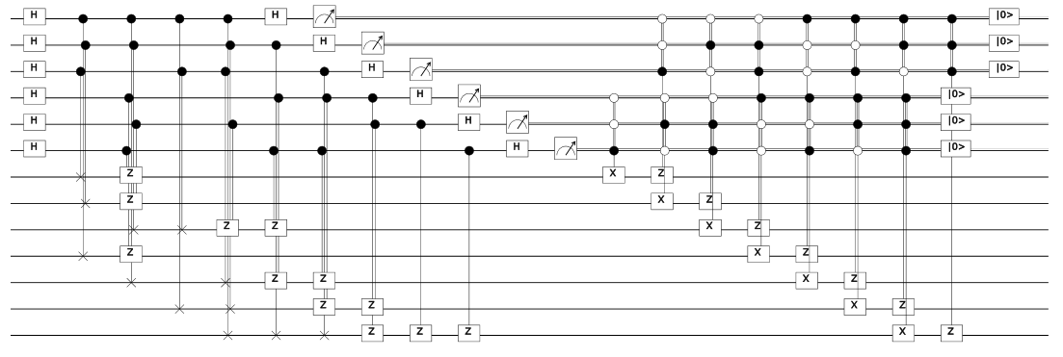
Gate Definition: Steane [[7,1,3]] Syndrome Meas.
Microsoft Proprietary

Slide 40
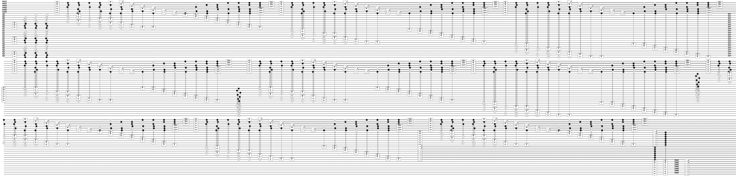
Full Teleport Circuit in Steane [[7,1,3]] Code
3 qubits encoded in 27
Microsoft Proprietary

Slide 41
Stabilizer Simulation
let tele1 (qs:Qubits) = X qs; teleport qs; M [qs.[2]]
let tgtC1 = Circuit.Compile tele1 qs
let s7 = Steane7(tgtC1)
let s7C = s7.Circuit
let stab = Stabilizer(s7c,s7.Ket)
stab.Run()
let bit0,dist0 = s7.Log2Phys 0 |> s7.Decode
let bit1,dist1 = s7.Log2Phys 1 |> s7.Decode
let bit2,dist2 = s7.Log2Phys 2 |> s7.Decode
> LIQUiD -test qecc
0:0000.0/LOOP[Zer0]: InjectedXYZ(0,0,0) Fixes=0 (Zero, One,Zero) dist=(0,0,0)
0:0000.0/LOOP[Zer1]: InjectedXYZ(0,1,0) Fixes=2 ( One,Zero,Zero) dist=(0,0,0)
0:0000.0/LOOP[Zer2]: InjectedXYZ(0,1,1) Fixes=2 (Zero,Zero,Zero) dist=(0,0,0)
0:0000.0/LOOP[Zer3]: InjectedXYZ(0,1,1) Fixes=0 (Zero,Zero,Zero) dist=(0,0,1)
0:0000.0/LOOP[Zer4]: InjectedXYZ(1,1,0) Fixes=3 (Zero, One,Zero) dist=(0,0,0)
0:0000.0/LOOP[Zer5]: InjectedXYZ(1,0,0) Fixes=2 ( One,Zero,Zero) dist=(0,0,0)
0:0000.0/LOOP[Zer6]: InjectedXYZ(0,1,0) Fixes=2 (Zero, One,Zero) dist=(0,0,0)
0:0000.1/LOOP[Zer7]: InjectedXYZ(1,0,0) Fixes=1 ( One,Zero,Zero) dist=(0,0,0)
0:0000.1/LOOP[Zer8]: InjectedXYZ(1,1,0) Fixes=3 ( One,Zero,Zero) dist=(0,0,0)
0:0000.1/LOOP[Zer9]: InjectedXYZ(0,1,0) Fixes=1 ( One, One,Zero) dist=(0,0,0)
0:0000.1/LOOP[One0]: InjectedXYZ(0,0,0) Fixes=0 (Zero, One, One) dist=(0,0,0)
0:0000.1/LOOP[One1]: InjectedXYZ(1,0,0) Fixes=1 (Zero, One, One) dist=(0,0,0)
0:0000.1/LOOP[One2]: InjectedXYZ(0,0,1) Fixes=1 ( One, One, One) dist=(0,0,0)
0:0000.1/LOOP[One3]: InjectedXYZ(0,1,1) Fixes=3 (Zero,Zero, One) dist=(0,0,0)
0:0000.1/LOOP[One4]: InjectedXYZ(0,0,1) Fixes=1 ( One, One, One) dist=(0,0,0)
0:0000.1/LOOP[One5]: InjectedXYZ(0,0,1) Fixes=1 ( One,Zero, One) dist=(0,0,0)
0:0000.1/LOOP[One6]: InjectedXYZ(1,0,0) Fixes=1 (Zero,Zero, One) dist=(0,0,0)
0:0000.1/LOOP[One7]: InjectedXYZ(0,1,0) Fixes=1 (Zero, One, One) dist=(0,0,0)
0:0000.1/LOOP[One8]: InjectedXYZ(1,0,1) Fixes=0 (Zero,Zero, One) dist=(0,0,1)
0:0000.1/LOOP[One9]: InjectedXYZ(1,1,0) Fixes=3 (Zero, One, One) dist=(0,0,0)
Microsoft Proprietary

Slide 42


Advanced Noise Modeling
Noise(circ:Circuit,ket:Ket,models:NoiseModels)
type NoiseModel = {
gate: string // Gate name (ending with "*" for wildcard match)
maxQs: int // Max qubits that gate uses
time: float // floating duration of gate (convention Idle = 1.0)
func: NoiseFunc // Noise Model to execute
gateEvents: NoiseEvents // Stats for normal gates
ecEvents: NoiseEvents // Stats for EC gates
}
member n.DampProb // Get/Set damping probability on a qubit
Microsoft Proprietary

Slide 43
A Software Architecture for Quantum Computing
High-level Quantum Algorithm
Quantum Gates
Quantum Function Implementation
Quantum Circuit Decomposition
Quantum Circuit Optimization
Quantum Error Correction
Simulation
Runtime Environments
Target-dependent Optimization
Layout, Scheduling, Control
Target-dependent Representation
Classical Control/Quantum Machine Instructions
The LIQ$Ui|⟩ \text{platform}$
[Wecker and Svore, 2014]

Slide 44


LIQ$Ui|⟩$ for Compilation onto Hardware
let QFT (qs : Qs) =
let n = qs.Length - 1
for i = 0 to n do
let q = qs.[i]
H q
for j = (i + 1) to n do
let theta = 2.0 * Math.PI /
float(1 <<< (j - i + 1))
CRz theta qs.[j] q
for i = 0 to ((n - 1) / 2) do
SWAP qs.[i] qs.[n - i]
let QftOp = compile QFT
let QftOp’ = adjoint QftOp
Microsoft Proprietary

Slide 45


LIQ$Ui|⟩$ for Compilation onto Hardware
Microsoft Proprietary
[Image: Hyart et al 2013, arXiv: 1303.4379]
[Image: L. DiCarlo, arXiv:1411.5542]

Slide 46
A Software Architecture for Quantum Computing
High-level Quantum Algorithm
Quantum Gates
Quantum Function Implementation
Quantum Circuit Decomposition
Quantum Circuit Optimization
Quantum Error Correction
Simulation
Runtime Environments
Target-dependent Optimization
Layout, Scheduling, Control
Target-dependent Representation
Classical Control/Quantum Machine Instructions
The LIQ$Ui|⟩ \text{platform}$
[Wecker and Svore, 2014]

Slide 47
Quantum Software Architecture: Mapping Quantum Algorithms to Devices
January 11, 2015
QIP 2015
Krysta Svore
Quantum Architectures and Computation Group (QuArC)
Microsoft Research

Slide 48
Compiling a Quantum Algorithm
High-level Quantum Algorithm
Quantum Circuit Decomposition
Target-dependent Representation
The LIQ$Ui|⟩ \text{platform}$
[Wecker and Svore, 2014]

Slide 49
Quantum compiling
Quantum algorithm
Quantum computer

Slide 50
Quantum compiling
Quantum algorithm
Quantum computer
Error correction
{ ,H,T}

Slide 51

Quantum compiling
Quantum algorithm
Quantum computer
Error correction
{ ,H,T}

Slide 52



Universality theorem

Slide 53


Operations on subspaces

Slide 54


Controlled rotations

Slide 55


Outline of universality theorem

Slide 56


Decomposition into single-qubit gates and CNOTs
See , e.g., [Cybenko 2001] [Aho and Svore 2003] [Vartianen et al. 2004][Kliuchnikov 2013]

Slide 57
Quantum compiling
Quantum algorithm
Quantum computer
Error correction
{ ,H,T}

Slide 58
Quantum compiling
Quantum algorithm
Arbitrary rotation about a given axis
We do not have methods to error-correct an arbitrary rotation!
Solution: Approximate with a sequence of gates from a “correctable” set of operations
Quantum computer
Error correction
{ ,H,T}

Slide 59
Quantum compiling
Quantum algorithm
Quantum computer
Error correction
{ ,H,T}

Slide 60
Quantum compiling
Quantum algorithm
≈ HTHTHTHTHTHTHTH
THTHTHTHTHTHTH...
Quantum computer
Error correction
{ ,H,T}

Slide 61

Quantum compiling
Quantum algorithm
≈ HTHTHTHTHTHTHTH
THTHTHTHTHTHTH...
Quantum computer
Error correction
{ ,H,T}

Slide 62
Quantum compiling
Quantum algorithm
≈ HTHTHTHTHTHTHTH
THTHTHTHTHTHTH...
Quantum computer
Error correction
{ ,H,T}

Slide 63

Quantum compiling
Quantum algorithm
Axial rotations
[Selinger 2012]
[Kliuchnikov,Maslov, Mosca 2012]
worst case
≈ HTHTHTHTHTHTHTH
THTHTHTHTHTHTH...
“average” case
Quantum computer
Quantum computer
Error correction
repeat-until-success
{ ,H,T}

Slide 64












Instruction Sets: Universal Single-qubit Bases
$T$ + Clifford ($H,X,Y,Z,I,S$)
$$T= \left[\begin{matrix}1 & 0 \\ 0 & e^{iπ/4}\end{matrix}\right]$$
$V_{3}$ + Clifford ($H,X,Y,Z,I,S$)
$$V_{3}=\frac{1}{\sqrt{5}}\left[\begin{matrix}1+2i & 0 \\ 0 & 1−2i\end{matrix}\right]$$
Fibonacci anyon basis:
$${{ σ}_{1}=\left[\begin{matrix}−ω & 0 \\ 0 & ω^{3}\end{matrix}\right], σ}_{2}=\left[\begin{matrix}ω^{4}τ & −ω^{2}\sqrt{τ} \\ −ω^{2}\sqrt{τ} & −τ\end{matrix}\right],$$
$$ω=e^{iπ/5}, τ=\frac{\sqrt{5} −1}{2}$$
$$H$$
$$T$$
$$S$$
$$Z$$
$$X$$
$$H$$
$$V$$
$$S$$
$$Z$$
$$X$$

Slide 65




Single-qubit unitary approximation
Input
$U$: 2x2 unitary matrix (assume a z-rotation by angle $θ$)
$U= \left[\begin{matrix}1 & 0 \\ 0 & e^{iθ}\end{matrix}\right]$
$ε$: approximation error
Output
$G_{1},G_{2},…, G_{l}$: sequence of gates
Constraint
$\left|\left|U−G_{1}G_{2}…G_{l}\right|\right|≤ε$
$$G_{1},G_{2},…, G_{l}∈\{CNOT, H, S, T\}$$
$$S=\frac{π}{2}$$
$$T=\frac{π}{4}$$

Slide 66






Solovay-Kitaev Theorem
$$H$$
$$T$$
$$S$$
$$Z$$
$$X$$
Two important complexities are implied
Cost for finding the sequence, i.e., classical compilation time
Cost of the sequence, i.e., the length of the word over the instruction set
[Source: Dawson, Nielsen, quant-ph/0505030]

Slide 67

Solovay-Kitaev Algorithm: de facto standard until 2012!
Basic idea: Successive refining of a net using commutators
Implementations:
[Kitaev, Shen, Vyalyi, AMS 2002]: log^{3+δ} (1/ε) time, log^{3+δ}(1/ε) length
w/ancilla: log² (1/ε) log log (1/ε) time, log² (1/ε) log log (1/ε) length
[Dawson, Nielsen, quant-ph/0505030]: log^{2.71} (1/ε) time, log^{3.97} (1/ε) length
[Harrow, Recht, Chuang, quant-ph/0111031]: non-constructive, log (1/ε) length
[Image source: Nielsen/Chuang, CUP 2000]

Slide 68

Year 2012: New Synthesis Methods
(based on algebraic number theory)
[Kliuchnikov/Maslov/Mosca’12]

Slide 69

How much cost improvement?

Slide 70

How much cost improvement?
Can we do even better?
Achieve length with c=1 with efficient randomized algorithm
Length vs
precision vs
compile time:
A typical implementation of Solovay-Kitaev algorithm requires 1.5 10⁴ T gates to achieve precision of 10⁻¹⁵

Slide 71

Paper (Date) | Contributions
arXiv:1206.5236 ¹ | Algorithm for exact synthesis of single-qubit unitaries
arXiv:1212.0506 ² | Exact synthesis of multi-qubit unitaries over the ring.
arXiv:1212.0822 ¹ | Exact synthesis of multi-qubit unitaries and number theory for asymptotically optimal approximation using ancillary qubits
arXiv:1212.6253 ² | Poly algorithm for approximating single qubit unitaries using at most 4 log(1/ε) + C T gates. Use of algebraic number theory
arXiv:1212.6964 ¹ | Exhaustive round-off gives better constant of strictly <4.
arXiv:1311.1074 ⁰ | Emergence of RUS designs. Scaling of the constant below 3 but the method uses database and is not efficient.
arXiv:1403.5280 (Duclos-Cianci/Poulin) | Using offline distillation to enhance the underlying gate set. Very efficient compilation algorithm, better constant. Large offline cost.
arXiv:1403.2975² | Using shearings, the constant was improved to 3 log(1/ε).
arXiv:1404.5320 ⁰ | Using integer relation algorithms to find better approximations for z-rotations via RUS designs. Constant improved to 1.15 log(1/ε).
arXiv:1409.3552 ⁰ | Using integer relation algorithms to find better approximations for z-rotations via PQF designs. Constant improved to 1 log(1/ε).
Additional papers show how to solve for other instruction sets (Fibonacci anyons, metaplectic anyons)
⁰ (QuArC) ¹ (Kliuchnikov, Mosca, Maslov) ² (Selinger et al)

Slide 72

Paper (Date) | Contributions
arXiv:1206.5236 ¹ | Algorithm for exact synthesis of single-qubit unitaries
arXiv:1212.0506 ² | Exact synthesis of multi-qubit unitaries over the ring.
arXiv:1212.0822 ¹ | Exact synthesis of multi-qubit unitaries and number theory for asymptotically optimal approximation using ancillary qubits
arXiv:1212.6253 ² | Poly algorithm for approximating single qubit unitaries using at most 4 log(1/ε) + C T gates. Use of algebraic number theory
arXiv:1212.6964 ¹ | Exhaustive round-off gives better constant of strictly <4.
arXiv:1311.1074 ⁰ | Emergence of RUS designs. Scaling of the constant below 3 but the method uses database and is not efficient.
arXiv:1403.5280 (Duclos-Cianci/Poulin) | Using offline distillation to enhance the underlying gate set. Very efficient compilation algorithm, better constant. Large offline cost.
arXiv:1403.2975² | Using shearings, the constant was improved to 3 log(1/ε).
arXiv:1404.5320 ⁰ | Using integer relation algorithms to find better approximations for z-rotations via RUS designs. Constant improved to 1.15 log(1/ε).
arXiv:1409.3552 ⁰ | Using integer relation algorithms to find better approximations for z-rotations via PQF designs. Constant improved to 1 log(1/ε).
Additional papers show how to solve for other instruction sets (Fibonacci anyons, metaplectic anyons)
YES!!!
⁰ (QuArC) ¹ (Kliuchnikov, Mosca, Maslov) ² (Selinger et al)

Slide 73

Non-deterministic circuits
Example
HZTHTHTHTHTHTHTHTHTHTHTHTHTHTHTHTHTHTHTHTHTHTSHTHTHTSHT
SHTHTHTSHTSHTSHTSHTSHTHTSHTHTSHTSHTHTHTHTHTHTSHTHTSHTS
HTSHTHTHTHTHTSHTSHTSHTSHTHTHTSHTSHTSHTHTHTSHTSHTSHTSHS
67 T gates

Slide 74

Non-deterministic circuits
Exp[T] = 6.4
Outcome 0: $U|ψ〉 \operatorname{Pr}\left[0\right]=5/8$
Outcome 1: $Id|ψ〉 \operatorname{Pr}\left[1\right]=3/8$
Example
HZTHTHTHTHTHTHTHTHTHTHTHTHTHTHTHTHTHTHTHTHTHTSHTHTHTSHT
SHTHTHTSHTSHTSHTSHTSHTHTSHTHTSHTSHTHTHTHTHTHTSHTHTSHTS
HTSHTHTHTHTHTSHTSHTSHTSHTHTHTSHTSHTSHTHTHTSHTSHTSHTSHS
67 T gates

Slide 75
Non-deterministic circuits
Exp[T] = 6.4
Outcome 0: $U|ψ〉 \operatorname{Pr}\left[0\right]=5/8$
Outcome 1: $Id|ψ〉 \operatorname{Pr}\left[1\right]=3/8$
Repeat-Until-Success
circuit
...
measure

Slide 76
Non-deterministic circuits
Exp[T] = 6.4
Outcome 0: $U|ψ〉 \operatorname{Pr}\left[0\right]=5/8$
Outcome 1: $Id|ψ〉 \operatorname{Pr}\left[1\right]=3/8$
Repeat-Until-Success
circuit
circuit
...
measure
...
measure

Slide 77
Non-deterministic circuits
Exp[T] = 6.4
Outcome 0: $U|ψ〉 \operatorname{Pr}\left[0\right]=5/8$
Outcome 1: $Id|ψ〉 \operatorname{Pr}\left[1\right]=3/8$
Repeat-Until-Success
circuit
circuit
...
measure
...
measure
R

Slide 78
Repeat-Until-Success circuits
How can we efficiently construct RUS circuits?
Repeat-Until-Success
circuit
circuit
...
measure
...
measure
R

Slide 79

Repeat-Until-Success circuits
How can we efficiently construct RUS circuits?
Repeat-Until-Success
circuit
circuit
...
measure
...
measure
R

Slide 80


Examples for RUS protocols
Improved T-count
by replacing Toffoli
[Jones’12]
Implements $V_{3}=(I+2iZ)/\sqrt{5}$ which corresponds to a z-rotation $R_{z}\left(θ\right)$ with $cos(θ)=$3/5
Probability of success $p_{success}=\frac{5}{8}$
Failure branches: all lead to identity $I_{2}$ [Nielsen/Chuang’00]
Found by enumeration
[Paetznick/Svore’13]

Slide 81


Brute-force search
Elements of search space / general layout:
Found many interesting circuits
[Paetznick and Svore’13]

Slide 82





Approximation: Unitary versus RUS
$$W=\left[\begin{matrix}x & −y^{∗} \\ y & x^{∗}\end{matrix}\right], x∈ℤ[i,\frac{1}{\sqrt{2}}]$$
Complete enumeration of $〈H, T〉$ unitaries
of T-count $L≤8$(i.e., $ℓ≤4)$. Red
denotes if within 0.98 of a Z-rotation.
#Unitary-approx=40
Enumeration of RUS protocols with
expected T-count $L_{exp}≤7.5$,
Blue points have $p_{success }≥0.8$
#RUS-approx=144

Slide 83



Markov Chains and Measurements
Random Walk:
Consider a walk on a set of unitaries
Let target Z-rotation be absorbing state of the walk
Repeat-Until-Success (RUS):
Failure branches are identity
No correction necessary
Potentially unlimited run-time (with very small probability)
Cost:

Slide 84


Markov Chains and Measurements
Random Walk:
Consider a walk on a set of unitaries
Let target Z-rotation be absorbing state
Probabilistic Quantum Circuit w/Fallback (PQF):
Corrections performed adaptively
Guaranteed to terminate
Cost:
Expected cost: $\frac{C_{P}\left(ε\right)}{p}+O\left(q^{k}\right), k>0$
Variance: $\frac{C_{P}{\left(ε\right)}^{2}q}{p^{2}}+O(q^{k})$

Slide 85




Compiling Z-rotations: Overview
Stage 1: Integer relation problem: solve it, e.g., by
using PSLQ or LLL
Stage 2: Sample space
problem: generate
enough modifiers
$$\frac{1}{ν^{L}}\left[\begin{matrix}z & y \\ −y^{∗} & z^{∗}\end{matrix}\right]$$
Stage 3: Number theory
problem: solve norm
equation over $ℚ\left(ω_{\{4,8,12\}}\right)$
Stage 4: Implement
resulting 2-qubit unitary:
exploit special form
Bottom line: All compiling stages run fast in practice, even for high accuracy ($ε={10}^{−35}).$
Numerical evidence for $T$-count of $1\log_{2}\left(\frac{1}{ε}\right)$, as opposed to the $3\log_{2}\left(\frac{1}{ε}\right)$bound for unitaries.

Slide 86



Stage 1: Integer Relations
$$d<m$$
$$m∈\{4,8,12\}$$
Let
$$z=a_{d−1} ω^{d−1}+a_{d−2} ω^{d−2}+…+a_{1} ω+a_{0}, z∈ℤ\left[ω\right], a_{i}∈ℤ, ω=e^{2πi/m}.$$
Then $q={z^{∗}}/z$ is an $ε$-approximation of $e^{iθ}$ iff
$$a_{d−1} x_{d−1}(θ) +a_{d−2}x_{d−2}(θ)+…+a_{1}x_{1}(θ)+a_{0}x_{0}(θ)$$
is a $δ$-approximation of zero, where $δ=ε \left|z\right|, x_{j}(θ)=sin⁡(\frac{θ}{2}+\frac{2πj}{m})$, $j=0,…,d−1$
$$\frac{1}{ν^{L}}\left[\begin{matrix}z & y \\ −y^{∗} & z^{∗}\end{matrix}\right]$$
PSLQ algorithm: [Bailey et al, ‘92] finds integer relations of the form
$$a_{1}x_{1}+…+a_{n}x_{n}=0$$
where $x_{1},…x_{n}$ are known irrationals and $a_{1},…,a_{n}$ are unknown integers.
This perfectly fits our needs! We just solve for $a$.

Slide 87

Stage 2: Sampling
Now we have $q={z^{∗}}/z, z∈ℤ[ω]$.
Find a two-qubit RUS (PQF) circuit of nearly optimal expected $\{V,T,\frac{π}{12}\}$-cost that implements $R_{z}(\arg{(q)})$.
$∀ r$ in the real subring of $ℤ[ω]$
$${{(r z)}^{∗}}/{\left(r z\right)=q}$$
We define a search space of moderate size to quickly find an $r$ in that space, such that
(1) there exists a two-qubit RUS (PQF) circuit implementing
$${{(r z)}^{∗}}/{\left(r z\right)}$$
(2) the one-round success probability of that circuit is close to $1$.
For randomly selected $r$ define $L_{r}=\left\lceil \log_{ν}{(}\right.\left.|r z{\left.​\right|}^{2})\right\rceil$ and observe that the anticipated success probability ${|r z{\left.​\right|}^{2}}/{2^{L_{r}}}$ is a random value in the $(0.5,1)$ interval.

Slide 88


Stage 3: Norm Equation
For given $z∈ℤ[ω]$ , find an $r$ such that for some integer $L_{r}$ the norm equation
$${\left|y\right|}^{2}=ν^{2L_{r}}−{\left|rz\right|}^{2}$$
can be solved for $y∈ℤ[ω]$.
The norm equation ${\left|y\right|}^{2}=ξ$ is only solvable …
… for a certain fraction of “good” right-hand sides $ξ$.
The “good” $ξ$’s are at least as frequent as prime numbers of the form $p=1 mod m$.
We have complete freedom in choosing $L_{r}$ and $r$.
Heuristic arguments show we hit a “good” solution infinitely often.
$$\frac{1}{ν^{L_{r}}}\left[\begin{matrix}rz & y \\ −y^{∗} & rz^{∗}\end{matrix}\right]$$

Slide 89



Stage 4: Implementing the RUS
For any cyclotomic integer $z∈ℤ[ω]$consider $θ=\arg{({z^{∗}}/z)}$. The z-rotation $R_{z}(θ)$ can be implemented exactly by a two-qubit RUS circuit over the Clifford+T basis.
$$u=r z /{\left(\sqrt{2}\right)}^{L},v=y/{{\left(\sqrt{2}\right)}^{L}}$$
Then the RUS based of the following two qubit unitary
$$\left[\begin{matrix}u & −v^{∗} & 0 & 0 \\ v & u^{∗} & 0 & 0 \\ 0 & 0 & u^{∗} & v^{∗} \\ 0 & 0 & {−v}^{ } & u\end{matrix}\right]=\left[\begin{matrix}V & \\ & V^{†} \end{matrix}\right]≔J(V)$$
implements $R_{z}(θ)$ on measurement of $0$
implements $Id$ on measurement of 1
One-round Success Rate: ${|{r z\left.​\right|}^{2}}/{2^{L}}$
$T$ count of $J(V)$ is at most the $T$ count of $V$ + 9
“Jack-of-Daggers”

Slide 90



Stage 4: Implementing the PQF
For any cyclotomic integer $z∈ℤ[ω]$consider $θ=\arg{({z^{∗}}/z)}$. Then z-rotation $R_{z}(θ)$ can be implemented exactly by a two-qubit PQF circuit over the Clifford+T basis.
$$u=r z /{\left(ν\right)}^{L_{r}},v=y/{{\left(ν\right)}^{L_{r}}}$$
Then the PQF based of the following two qubit unitary
$$CNOT\left(I⊗V\right)CNOT=\left[\begin{matrix}V & \\ & XVX \end{matrix}\right]≔Q(V)$$
implements $R_{z}(θ)$ on measurement of $0$ on 2nd qubit
implements $R_{z}(θ^{′})$ on measurement of 1 on 2nd qubit
One-round Success Rate: ${|{r z\left.​\right|}^{2}}/{ν^{2L_{r}}}$
$\{V,T,\frac{π}{12}\}$ count of $Q(V)$ is exactly the $\{V,T,\frac{π}{12}\}$ count of $V$
“Queen-of-CNOTs”

Slide 91



Numerical Results: RUS and PQF
Precision vs. expected $T$-count
1000 random angles
30 target precisions
Success prob. $\sim 0.97$
Maximum likelihood estimate of mean exp. $T$-count for RUS
$$1.149\log_{2}\left(\frac{1}{ε }\right)+9.2$$
Maximum likelihood estimate of mean one-round exp. $T$-count for PQF
$${1 log}_{2}\left(\frac{1}{ε }\right)+4\log_{2}{(\log_{2}\left(\frac{1}{ε}\right))+1.187}$$
Factor of 3 improvement over unitary decomposition!
Surpasses information-theoretic unitary lower bound!

Slide 92
A Software Architecture for Quantum Computing
High-level Quantum Algorithm
Quantum Gates
Quantum Function Implementation
Quantum Circuit Decomposition
Quantum Circuit Optimization
Quantum Error Correction
Simulation
Runtime Environments
Target-dependent Optimization
Layout, Scheduling, Control
Target-dependent Representation
Classical Control/Quantum Machine Instructions
The LIQ$Ui|⟩ \text{platform}$
[Wecker and Svore, 2014]

Slide 93













Krysta
Svore
Matthew
Hastings
Burton
Smith
Dave
Wecker
Jon
Yard
Yuri
Gurevich
Alan
Geller
Alex
Bocharov
Vadym
Kliuchnikov
Doug
Carmean
Nathan
Wiebe
Martin
Roetteler
Ken
Reneris

Slide 94

http://research.microsoft.com/groups/quarc/
http://research.microsoft.com/en-us/labs/stationq/
ksvore@microsoft.com
© 2014 Microsoft Corporation. All rights reserved. Microsoft, Windows and other product names are or may be registered trademarks and/or trademarks in the U.S. and/or other countries.
The information herein is for informational purposes only and represents the current view of Microsoft Corporation as of the date of this presentation. Because Microsoft must respond to changing market conditions, it should not be interpreted to be a commitment on the part of Microsoft, and Microsoft cannot guarantee the accuracy of any information provided after the date of this presentation. MICROSOFT MAKES NO WARRANTIES, EXPRESS, IMPLIED OR STATUTORY, AS TO THE INFORMATION IN THIS PRESENTATION.

